Slide 1
HTML5, CSS and Javascript – part1
Dr Xi Guo

Slide 2
Content
Resources
HTML programming (follow me demo)
CSS programming (follow me demo)

Slide 3
Content
Resources
HTML programming (follow me demo)
CSS programming (follow me demo)

Slide 4
Resources to use
https://www.w3schools.com/
HTML learning :
https://www.w3schools.com/html/default.asp
https://discoverthreejs.com/book/appendix/html-and-css-reference/
CSS learning : https://www.w3schools.com/css/default.asp
Javascript:
https://www.w3schools.com/js/default.asp
https://discoverthreejs.com/book/appendix/javascript-reference/
Linkedlin learning :
HTML essential training(LinkedIn online course)
Responsive Layout Watch Session2(LinkedIn online course)
JavaScript Essential Training

Slide 5
Content
Resources
HTML programming (follow me demo)
CSS programming (follow me demo)

Slide 6
Activity– Follow me demo
Mini document – version HTML5
<!DOCTYPE html>
<html>
<head>
<title>
Put your page title here!
</title>
</head>
<body>
<h1>
HTML page title
</h1>
</body>
</html>
marks the start of a new HTML file
The <html> element is the root element of an HTML page
What is the <title> used for?
The <head> element contains meta information about the HTML page
The <body> element defines the document's body, and is a container for all the visible contents, such as headings, paragraphs, etc.

Slide 7
Activity– Basic elements
Practise using HTML elements
<h1>A heading element</h1>
<p>A paragraph element.</p>
<a>An anchor element</a>
<button>A button element</button>
Understand the DOM tree (Document Object Model)
<div>
<h1>A heading element</h1>
</div>
<div>
<p>A paragraph of test with a <a>link</a> inside it.</p>
</div>

Slide 8
Activity– Attribute
Attribute: The two most common attributes are id and class.
<button id="close-button">Click here to close!</button>
<h1 class="notice">A heading you want to stand out.</h1>
<p class="notice">Some text you want to stand out.</p>
<p style="color: skyblue;">This text will be red.</p>
<a href="https://discourse.threejs.org/">the three.js forum</a>
Reference CSS files : Normally under <head> tag
<link href="style.css" rel="stylesheet" type="text/css" />

Slide 9
Activity– Advanced elements
Hyperlink
<a href="https://discourse.threejs.org/">the three.js forum</a>
ID- Unique Identity
<button id="close-button">Click here to close!</button>
<h1 class="notice">A heading you want to stand out.</h1>
Class- Classes are not unique. You can have any number of elements:
<p class="notice">Some text you want to stand out.</p>
Style- NOTE: American spelling
<p style="color: skyblue;">This text will be red.</p>

Slide 10
What is HTML?
HTML is the standard markup language for Web pages.
It normally formatted like <tag_name>Something</tag_name>
The latest version is HTML5.
With HTML you can create your own Website.
HTML is easy to learn - You will enjoy it!
It is readable as soon as you speak English
It is not case sensitive.
HTML elements can have attributes. Such as id, name and class
Example: <div id=“id1” name=“name1” class=“bodydiv”></div>
DOM structure
https://www.w3schools.com/js/js_htmldom.asp

Slide 11
Activity– Forms
The form-handler is specified in the form's action attribute.
HTML Forms
<form action="/action_page.php">
<label for="fname">First name:</label><br>
<input type="text" id="fname" name="fname" value="John"><br>
<label for="lname">Last name:</label><br>
<input type="text" id="lname" name="lname" value="Doe"><br><br>
<input type="submit" value="Submit">
</form>
Defines a text input
Defines a button for submitting the form data to a form-handler.
Notes:
https://www.w3schools.com/html/html_forms.asp

Slide 12
Activity– Multimedia
Specifies the path to the image
Images: Make sure you use validated image and correct path
<img src="pic_trulli.jpg" alt="Italian Trulli">
Audio
<audio controls>
<source src="horse.ogg" type="audio/ogg">
<source src="horse.mp3" type="audio/mpeg">
Your browser does not support the audio element.
</audio>
NOTE: You may need to upload the multimedia before use it in the code
alt text are shown if the browser cannot find the image
Specifies the path to the audio
Specifies audio types
Notes:
https://www.w3schools.com/html/html5_audio.asp
https://www.w3schools.com/html/html_images.asp

Slide 13
Content
Resources
HTML programming (follow me demo)
CSS programming (follow me demo)

Slide 14
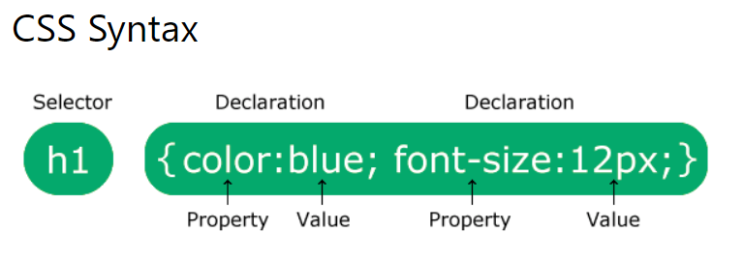
CSS- follow me demo
The declaration block contains one or more declarations separated by semicolons.
body {
background-color: lightblue;
}
h1 {
color: white;
text-align: center;
}
p {
font-family: verdana;
font-size: 20px;
}

Slide 15
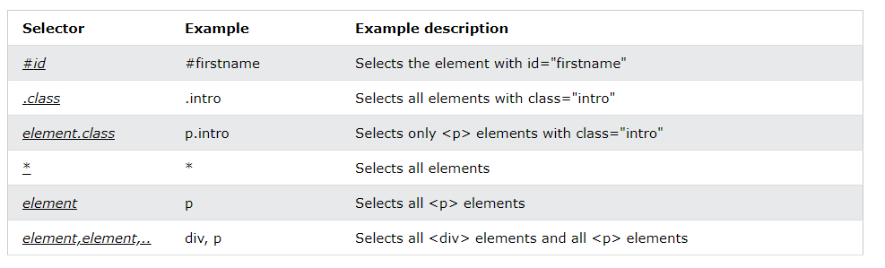
CSS- CSS selector

Slide 16
CSS- Where to use CSS?
External CSS : Normally under <head> tag
<link href="style.css" rel="stylesheet" type="text/css" />
Internal CSS
Inline CSS
Please check examples
https://www.w3schools.com/css/css_howto.asp

Slide 17
CSS- What is CSS?
CSS is the language we use to style an HTML document.
CSS describes how HTML elements should be displayed.
CSS is structured and readable-but American spelling.
Normally it formated like this feature_name:feature_value;
Example: background-color:Blue;
It is very important to learn CSS selector
https://www.w3schools.com/css/css_selectors.asp
It can be put inside of the HTML tags, or inside the <style></style>, or in a separate file.
https://www.w3schools.com/css/css_howto.asp

